Slide 1
BF PROJECT Sanket KHAMKAR SRK197
2024 Fall Intake - MITA

Slide 2

Forecasting U.S. Fertility Rates
This presentation explores the importance and methodology of predicting future trends in fertility and infant mortality rates in the United States. Using data from the CDC Natality Dashboard, we examine various forecasting models to accurately project these crucial health indicators for the coming years. Our analysis aims to support healthcare resource allocation, public health policy development, and long-term social and economic planning.

Slide 3

Fertility & Mortality Forecasting
Healthcare Resource Allocation
Public Health Policy
Forecasts assist in developing policies to improve maternal and infant health outcomes.
Predicting fertility rates helps allocate maternal health services and neonatal care effectively.
Economic and Social Planning
Addressing Disparities
Fertility trends impact future demographics, influencing education and childcare planning.
Forecasting helps identify and address healthcare inequities across different groups.

Slide 4
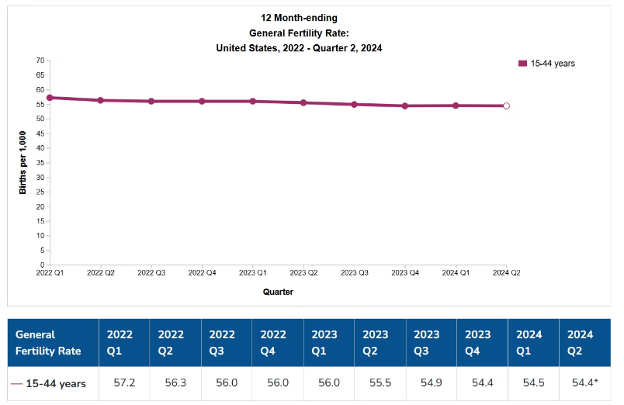
Computing rates and Source for Fertility Rate Data
Rates for "12 months ending with quarter" (also called moving average rate) are the average rates for the 12 months that end with the quarter on the horizontal (time) axis. Estimates for the 12-month period ending with a specific quarter include all seasons of the year and, thus, are insensitive to seasonality.
A hollow circle indicates that estimates for the most recent quarter are significantly different from the same quarter of the previous year (p < 0.05); these estimates are also flagged in the data table with an asterisk (*).
SOURCE: NCHS, National Vital Statistics System. Estimates for 2024 are based on provisional data. Estimates for 2022 and 2023 are based on final data (final data are available from: http://wonder.cdc.gov/).
Race and Hispanic origin refers to the mother.
NOTES: The general fertility rate refers to the total number of births per 1,000 women aged 15-44.

Slide 5
Provisional estimates are based on all complete birth records received and processed by the National Center for Health Statistics (NCHS) as of a specified cutoff date. National provisional estimates include events occurring to U.S. residents within the 50 states and District of Columbia. NCHS receives the birth records and monthly provisional occurrence counts from state vital registration systems through the Vital Statistics Cooperative Program. Provisional quarterly estimates are compared with final data when available
-Birth rates are calculated on an annual basis per 1,000 estimated population within specified age groups.
-The general fertility rate refers to the total number of births per 1,000 women aged 15-44. Birth rates for women aged 50 and over have historically been too small to compute reliable age-specific birth rates.
-Consistent with other reports, birth rates to women aged 45 and over are computed by including all births to women aged 45 and over in the numerator, while the denominator includes population estimates of women aged 45-49 year
-Other rates (e.g., preterm birth rates, term birth rates, cesarean delivery rates) are presented as per 100 births. Estimates of birth rates at 42 weeks gestation or later (post-term) are not presented due to the small number of births in this group.

Slide 6
Insights from Exploratory Data Analysis
1
Time Series Trends
2
Seasonality Patterns
Observed general trends in fertility and mortality rates over years, reflecting social changes and healthcare improvements.
Identified seasonal variations in birth rates and potential seasonal effects on infant mortality.
3
Regional Analysis
4
Demographic Insights
Noted differences between urban and rural areas, highlighting disparities in healthcare services and economic conditions.
Analyzed variations across age groups, ethnicities, and marital statuses, revealing important factors influencing rates.
5
Outlier Analysis
6
Correlation Between Variables
Sudden spikes or dips in fertility or mortality rates may be caused by significant events, such as economic recessions or health crises.
Examining correlations between factors like maternal age and infant mortality can highlight key risk factors for intervention.
For example, the COVID-19 pandemic likely led to anomalies in infant mortality rates due to disruptions in healthcare. These event-based anomalies can distort regular patterns and should be carefully considered in analysis.
Correlating healthcare access, such as prenatal care, with infant mortality rates can reveal the impact of medical interventions. This analysis helps prioritize efforts to improve child health outcomes.

Slide 7




Accuracy Measures for Forecasting Models
MAE
RMSE
MASE
Mean Absolute Error provides an easy-to-interpret average deviation, showing expected error magnitude.
Root Mean Squared Error emphasizes larger errors, helping ensure significant deviations are minimized.
Mean Absolute Scaled Error offers a comparative measure across time series, judging model quality relative to a naive benchmark.

Slide 8
Forecasting Methods and Residual Analysis
Method
Best Use Case
Residual Expectation
Mean Forecast
Stationary data (No trend or seasonality)
Random (Indicates good fit for mean-based prediction)
Naive Forecast
Short-term forecasts (Uses recent observation)
Random (Good for short-term, no trend or seasonality)
Seasonal Naive
Seasonal data (Repeating seasonal patterns)
Random (Residuals should show randomness if seasonality is captured)
Random Walk
Persistent trends (Data with a drift or trend)
(Residuals should be random when trend is well modeled)
Simple Exponential Smoothing (SES)
Level data (No trend or seasonality)
White noise (Residuals should resemble random noise)
Exponential Smoothing State Space Model (ETS)
Level, Trend, and Seasonality (Captures all components)
Random (Effective model fit with no autocorrelation)
Moving Average
Smoothing data (To reduce noise)
Lagging (Residuals often lag due to smoothing nature)
Holt-Winters
Trend and seasonality (Data with both components)
Random (Successful if residuals are random)
Decomposition
Trend, seasonal, residual components (Decomposes time series)
Random (Residuals show randomness after decomposition)
STL Decomposition
Non-linear seasonality (Handles complex trends and seasonality)
Random (Residuals should be random if decomposition is correct)
ARIMA
Complex time series
White noise, no autocorrelation

Slide 9

Model Comparison and Decision
After comparing various forecasting models based on MAE, RMSE, and MASE, the ARIMA model emerged as the best performer. It demonstrated the lowest RMSE (27.07818) and MAE (21.91507), indicating minimal errors and high accuracy. The ACF1 value (-0.0078) close to zero suggests random, non-autocorrelated residuals, further validating the model's effectiveness in capturing the underlying patterns in fertility and mortality rate data.
1
Data Input
2
Model Comparison
CDC Natality Dashboard data
Evaluate MAE, RMSE, MASE
3
Best Model
4
Forecast
ARIMA selected
Generate predictions
Provisional birth rate estimates are subject to non-random sampling error due to incomplete data, especially for recent months. While completion rates for the U.S. were above 95%, some states may have delayed reporting, potentially affecting the accuracy. However, provisional estimates closely align with final data, typically within 1-2% error, except for age groups with low birth rates (10-14 and 45+ years). These estimates are based on the assumption of random missing data. Timeliness of birth reporting is improving, so estimates may change over time as new data is added, with differences due to rounding or updated population estimates.

Slide 10

Ideas for Improving Forecasts
1
Incorporate Exogenous Variables
Include relevant external factors like economic indicators or weather patterns to improve prediction accuracy.
2
Regular Model Updates
Retrain forecasting models with the latest data to capture recent trends and seasonal patterns.
3
Ensemble Methods
Combine multiple forecasting models to reduce overfitting risk and improve generalization.
4
Feature Engineering
Create additional features such as lags or rolling averages to better understand complex dynamics.

